Slide 1


Marvel’s Infinity War Analysis
Wyatt PralL

Slide 2
Purpose
The purpose of this analysis is to analyze the new Marvel Infinity War reception in comparison to some of the other successful Marvel Movies.

Slide 3
Data Collection
The data will be retrieved from two locations the, first being twitter.
The second will be reviews for Infinity War and reviews for other Marvel movies from Rotten Tomatoes.

Slide 4
What will be Performed on the Tweets?
Sentiment Analysis
Topic Modeling
Hashtag Analysis
Original vs Retweets
Top Users
Mentioned Users
Urls

Slide 5
Tweet Statistics
8189 Total Tweets
5272 English Tweets
2438 Original tweets
5751 Retweets

Slide 6
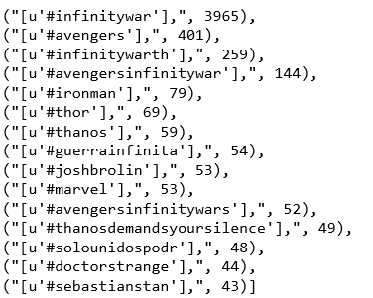
Hashtags
Top 15 Hashtags

Slide 7
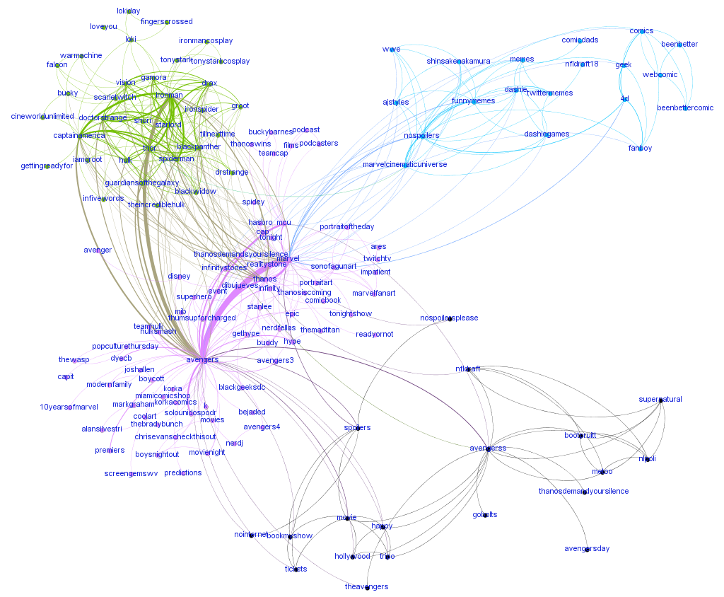
Hashtag Network
All of the hashtags were broke up by Modularity.
The top 4 Groups that make up 55.51 % of the hashtags .
There were 40 total Modularity Groups.

Slide 8
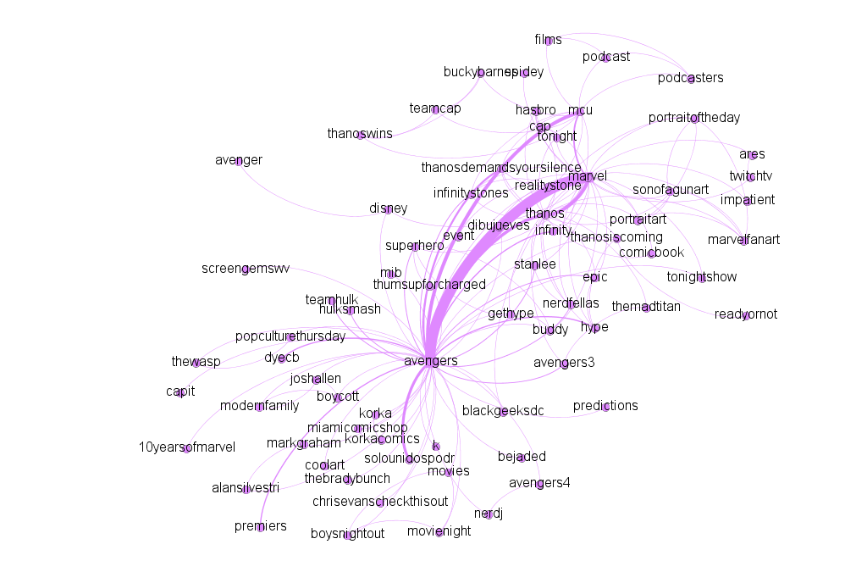
Top Hashtag Group
Group 2 made up 28.14% which was about the movie and facts in general such as 10 years of marvel.

Slide 9
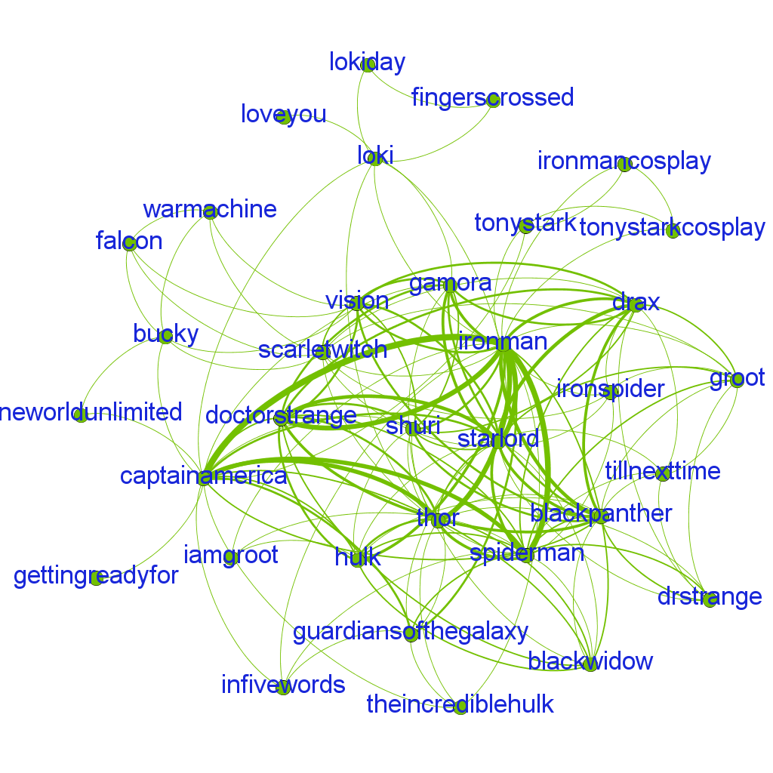
Second Largest Hashtag Group
Group 9 made up 12.93% which was about what actors and characters will appear in the movie.

Slide 10
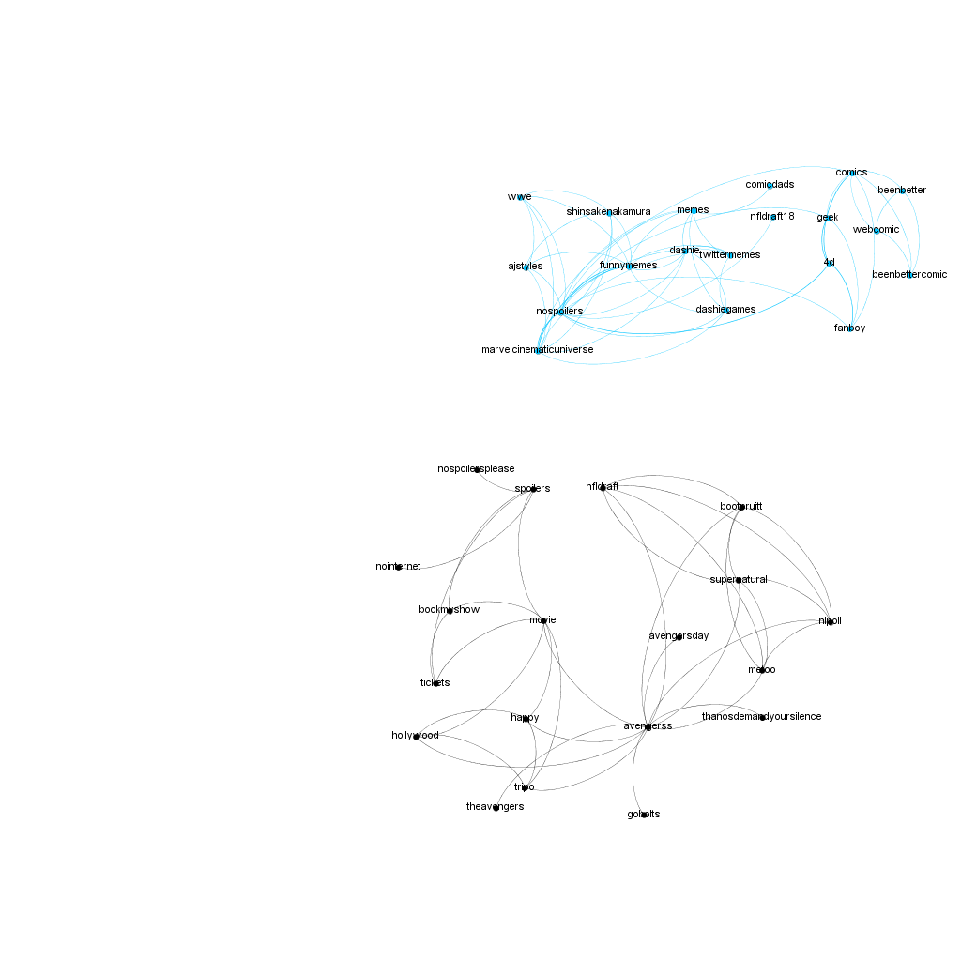
Third and Fourth
Group 3 and Group 10 tied for third place,both with 7.22%
Group 3 is referring to no spoilers for memes and comics
Group 10 is referring to the ticket sales and Hollywood

Slide 11
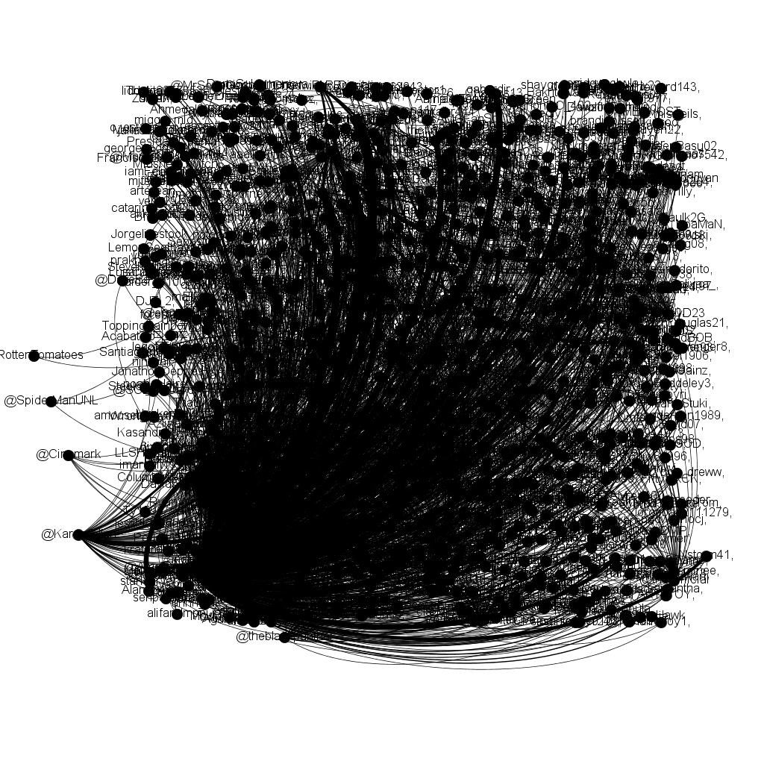
Mention network
As you can tell that this is a very popular topic. This Mention Network was just to show how many people were talking about this topic.

Slide 12
Top 4 Mention Network
The Top 4
@ Marvel Studios
@ ChadwickBoseman
@Avengers
@ChrisHemsworth

Slide 13
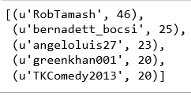
Top 5 Most Common Twitter Users
RobTamash is a Spanish user that talks about the movie
Bernadett_bosci is talking about the movie
angeloluis27 is talking about the movie
TKComedy2013 is talking about the movie
What I find interesting is that Greenkhan001 is not talking about the movie instead he is using that hashtag to promote his graphic design business. He uses other popular hashtags to promote his business.

Slide 14
URL
Total of 1492, unique URLS
The top URL is a link that will take you to Fandango. Fandango is a website used to buy tickets, this URL appeared 501 times.

Slide 15
Sentiment Analysis
Is the movie good?
458 Positive
149 Negative
872 Neutral
These tweets were acquired before the movie was released. I was hoping to discover that most people were anticipating the movie and that the reviews would be positive.

Slide 16
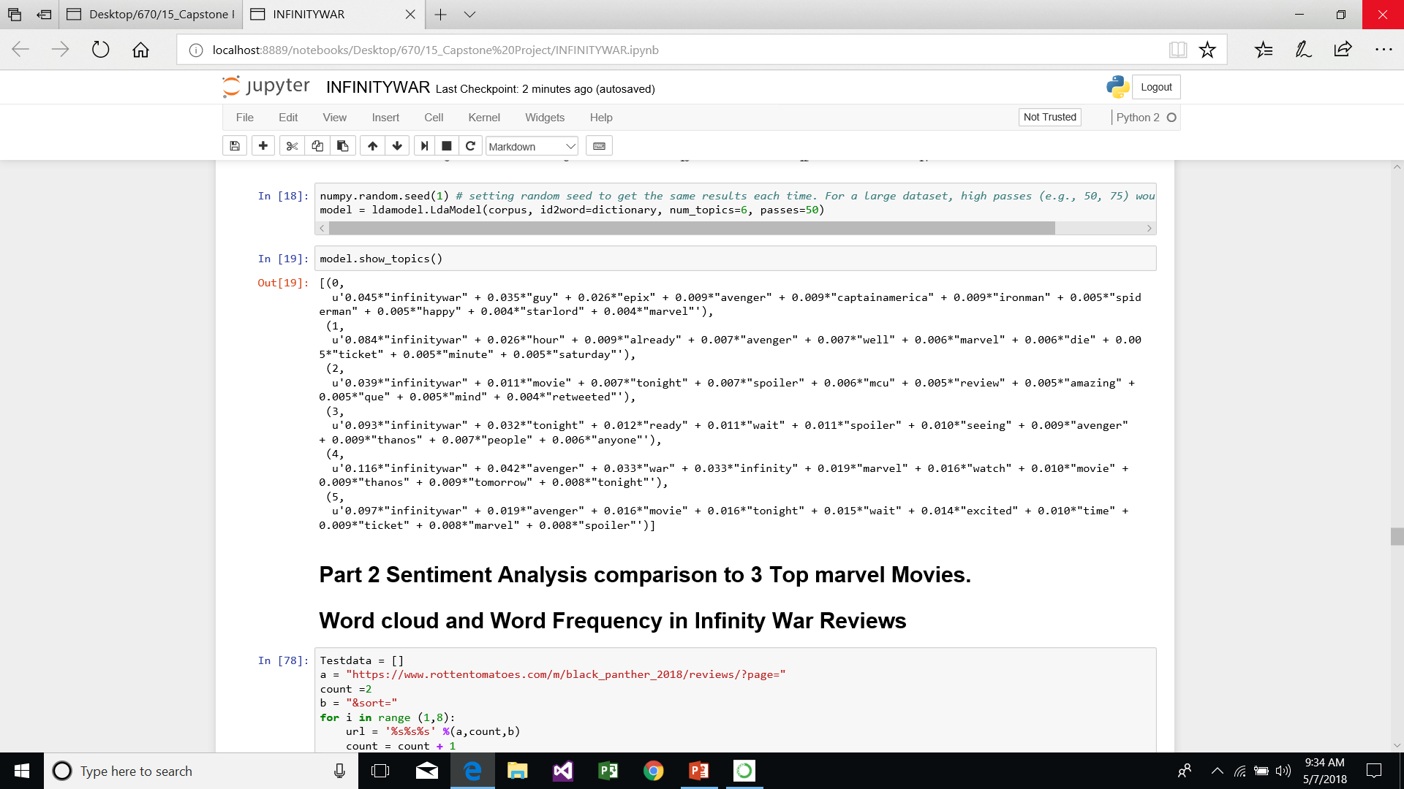
Topic Modeling
All are about the movie.

Slide 17
Review Comparison
I took 3 past Marvel Movies and wanted to compare the Sentiment Analysis of the movies
The 3 past movies are Guardians of the Galaxy , Iron Man and Black Panther
I took these 3 movies, put them into a variable, and compared the scores to the Infinity War reviews

Slide 18
Sentiment Review Findings
106 Positive Marvel Movies
21 Negative Marvel Movies
13 Neutral Marvel Movies
128 Positive Infinity War
34 Negative Infinity War
18 Neutral Infinity War

Slide 19
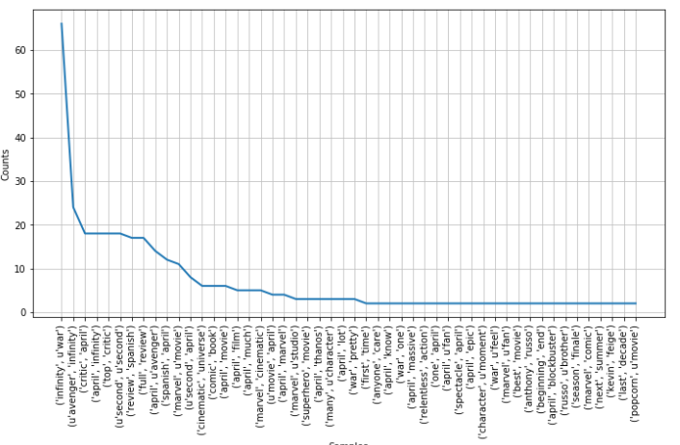
Bigram Distribution

Slide 20
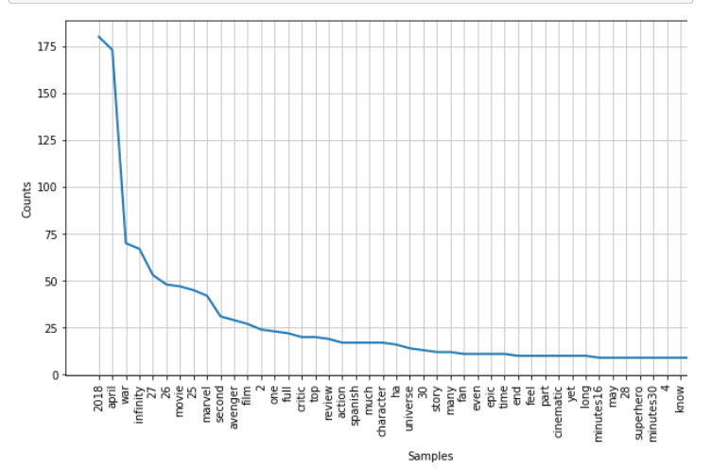
Word Distribution

Slide 21
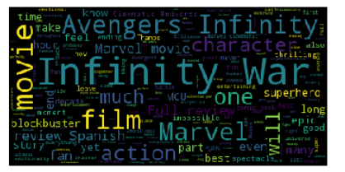
Word Cloud

Slide 22
Conclusion
Infinity War looks like a great addition to the Marvel cinematic universe. However, it does not seem to be the cinematic masterpiece that some people claim it to be. However, it is a huge blockbuster success currently making over 1 billion dollars.

